Slide 1


B -Capstone Project Phase
GiveUs-
an application for linking and coordinating donations
Zohar Barel
David Blanka

Slide 2


Contents
Introduction
Solution
product
Verification-Testing
Challenges
Demo video

Slide 3
Introduction- Background
❗ Today 21% of the population in Israel lives below the poverty line.
❗During the year 2021, 1600 tons(out of 2.6 million tons), with a value of 16 million NIS, were saved as part of the food rescue project of the organization "Latet"
❗But... how much food is not collected? How much food is thrown away due to lack of coordination, lack of knowledge or lack of accessibility?

Slide 4
NO MORE!!!
❗40% of the food in Israel is thrown away when more than half of it is edible!!!
coffee shop, dining rooms, event halls, supermarkets... everyone tries to contribute but it's not enough...

Slide 5

Solution
give-us is a system that connects between donors to association and also to private needy
This is the best way to connect large organizations with non-profit organizations and between small organizations and private needy
The system simplifies the whole donation issue, efficient the process, and saves valuable time
The system can prevent edible food being thrown away and donate it to non-profit organizations and also allow private individuals to collect surplus food from businesses in their area of house
Donating food has never been easier!

Slide 6
Solution- outline
Posting small donations
Link between large organizations and non-profit organizations
Accessibility to donors and those in need
Keeping the information about the donations

Slide 7
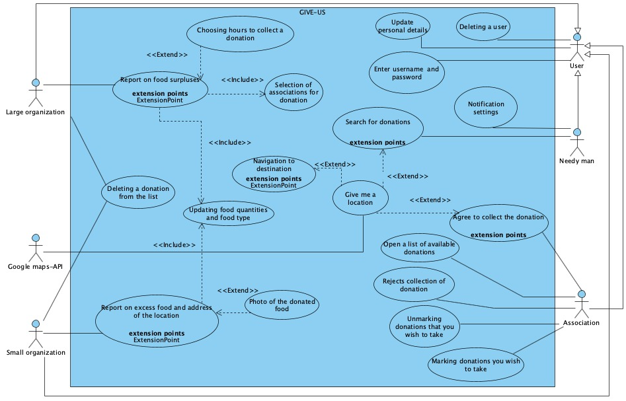
Product - Use Case diagram

Slide 8
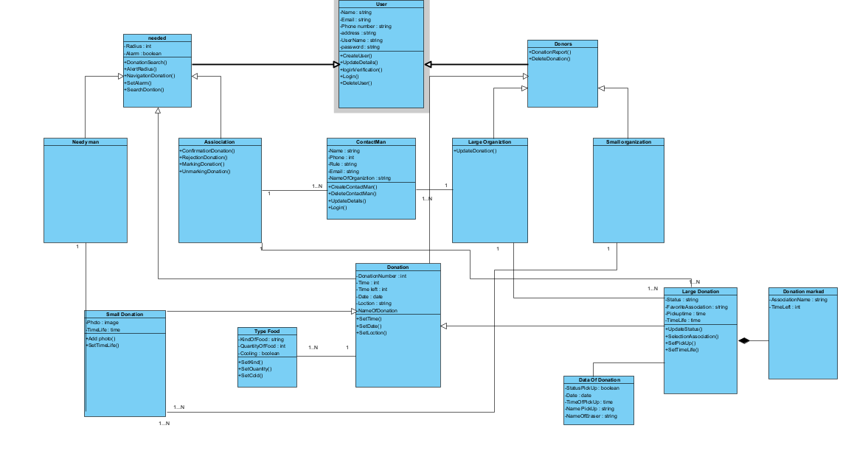
Class diagram

Slide 9
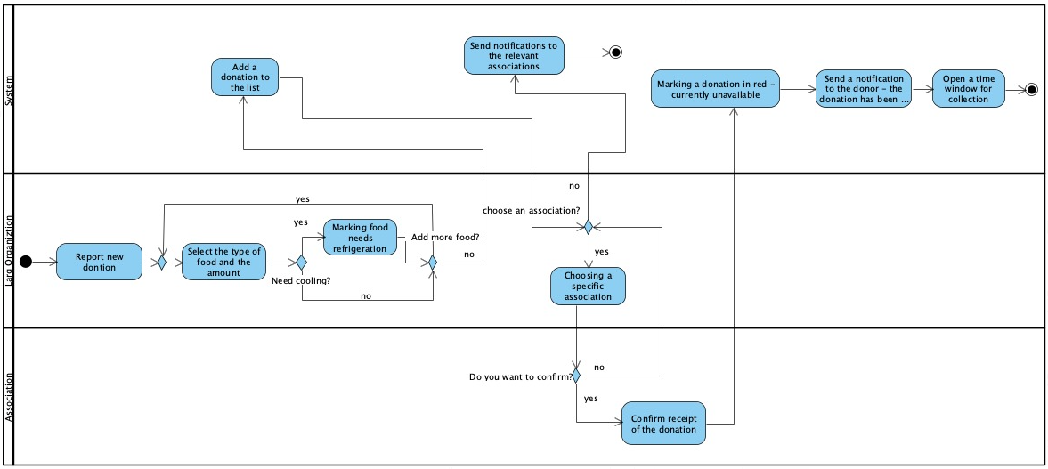
large donation of a large organization Activity Diagram

Slide 10
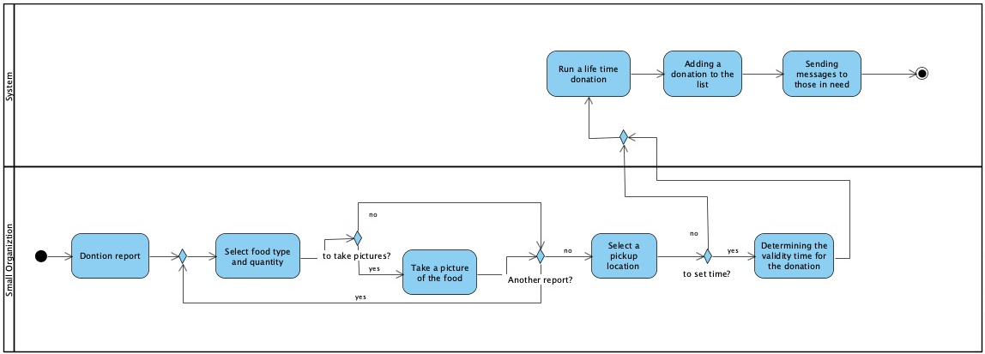
small donation of a small organization Activity Diagram

Slide 11
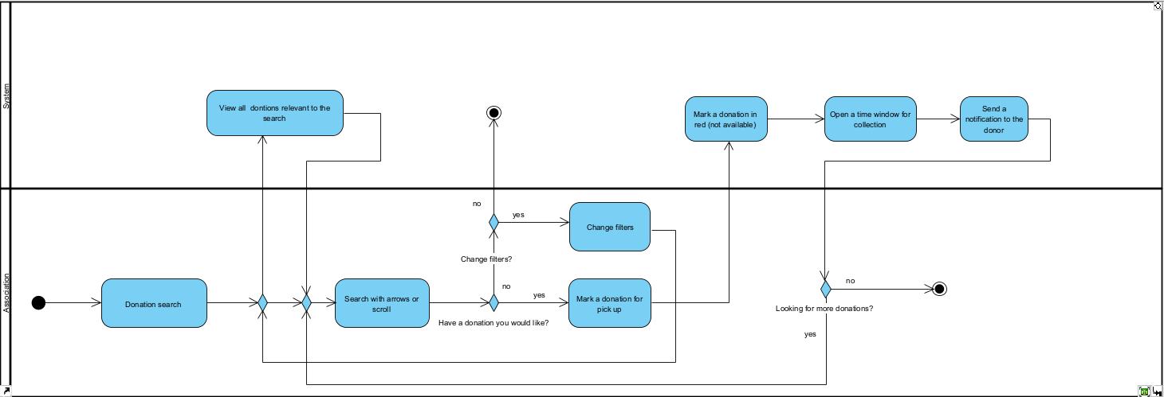
Search donation Activity Diagram

Slide 12


Programming languages we used
Front-End:
Html
CSS
JavaScript
Back-End:
Node.js
Express
MongoDB

Slide 13
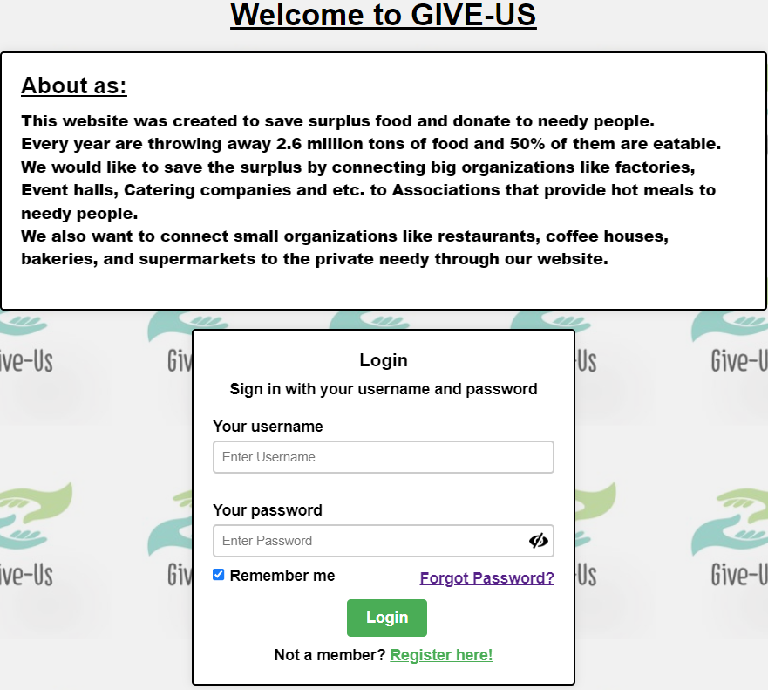
Login page

Slide 14
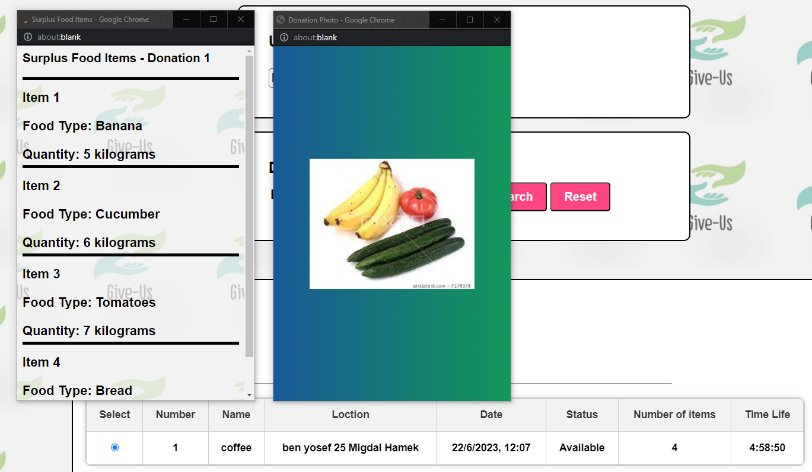
Search Donation

Slide 15
Testing
In order to test our system, we performed two types of evaluation tests:
The first is manual testing
The second is automated testing using a library that exists in JavaScript.

Slide 16
.1 | Login
 | Test Subject | Expected result | Result
1.1 | Username is empty | "Enter username" message on the screen | Successfully passed
1.2 | Empty or incorrect password for username | "Wrong password" message on the screen | Successfully passed
1.3 | Username does not exist | "Username does not exist in the system" message on the screen | Successfully passed
1.4 | User is already logged in | "User is already logged in please check" message on the screen | Successfully passed

Slide 17
2 | Registration
 | Test Subject | Expected result | Result
2.1 | Incomplete details | "Incomplete details please fill in the one marked with a star" message on the screen and a red mark | Successfully passed
2.2 | Invalid email | "Invalid email" message on the screen and a red mark | Successfully passed
2.3 | Invalid phone number | “Invalid phone number” message on the screen | Successfully passed
2.4 | Username(Email) exists | "Username exists" message on the screen | Successfully passed
2.6 | Password too weak | "Weak password" message on the screen | Successfully passed
2.7 | Invalid password validation | "Password verification does not match" message on the screen | Successfully passed

Slide 18
3 | Adding Contact Man
 | Test Subject | Expected result | Result
3.1 | Incomplete details | "Please fill in all fields" message on the screen | Successfully passed
3.2 | Invalid role | "Invalid role" message on the screen and a red mark | Successfully passed
3.3 | Invalid phone number | “Invalid phone number” message on the screen | Successfully passed

Slide 19
4 | Adding large donation
 | Test Subject | Expected result | Result
4.1 | Incomplete details | "Missing item information" message on the screen | Successfully passed
4.2 | Saving a donation without items | "Insert at least 1 item " message on the screen | Successfully passed
4.3 | Select Contacts | "The contacts have been successfully added" message on the screen | Successfully passed
4.4 | Choose an association to donate to | "The association was successfully selected" message on the screen | Successfully passed
4.5 | Click Save to add a donation | "The donation has been successfully saved" Message on screen | Successfully passed

Slide 20
5 | adding small donation
 | Test Subject | Expected result | Result
5.1 | Adding an item for donation | "The item was added in success" message on the screen | Successfully passed
5.2 | Adding an item without a quantity | "Add quantity to item" message on the screen | Successfully passed
5.3 | Adding an item without a unit of measure | "Select a unit of measure" message on the screen | Successfully passed
5.3 | Would you like to add a photo? | " Opening a window to add a picture" | Successfully passed
5.4 | Uploading a picture | " The image has been successfully added to the donation" message on the screen | Successfully passed

Slide 21
6 | Search donations- Association
 | Test Subject | Expected result | Result
6.1 | Search for a donation sent to me | Presentation of donations sent to the association The donations are shown in the table | Successfully passed
6.2 | Search for a donation by city | Presentation of donations according to the selected city The donations are shown in the table | Successfully passed
6.3 | View all donations in the system | View all donations The donations are shown in the table | Successfully passed
6.4 | Free donation marking | " The donation has been marked as successful" message on the screen An email has been sent to the donor | Successfully passed
6.5 | Marking a donation that is not available | "The donation is not available for collection" message on the screen | Successfully passed
6.6 | Show items of the donation | Displaying all the details of the donation | Successfully passed

Slide 22
7 | Search donations- Needy
 | Test Subject | Expected result | Result
7.1 | Search for a donation by city | Presentation of donations according to the selected city The donations are shown in the table | Successfully passed
7.2 | Show items of the donation | Displaying all the details of the donation | Successfully passed
7.3 | Show the picture of the donation | Show a picture of the donation | Successfully passed

Slide 23
Challenges
During the development we faced many challenges, here are some of them:
Develop a user-friendly app to get people to donate food and not be afraid of dealing with this sensitive issue
Work concurrently on the code using code version management
Learning new programming languages while developing software, technical problems, code bugs, many hours of online videos
Knowing how to combine personal life with work on the project

Slide 24
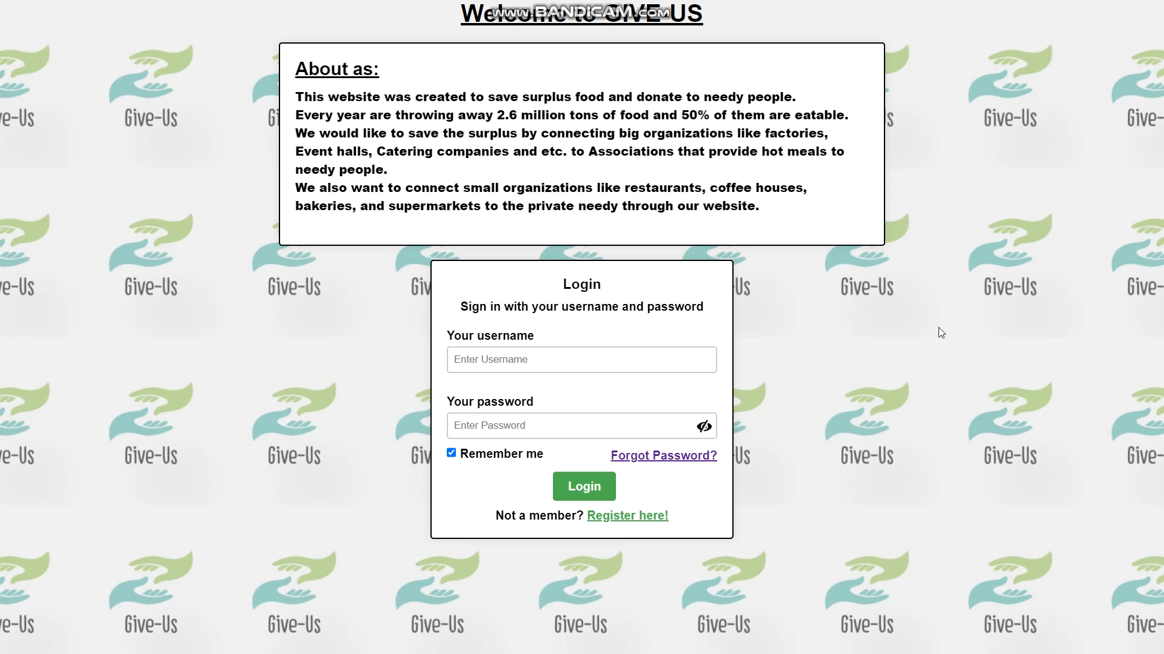
A short video of the project

Slide 25
Thank you for listening 🙌🏽
Go and donate!

